Slide 1
I/O Status to PC with LOGO! 0BA7

Slide 2
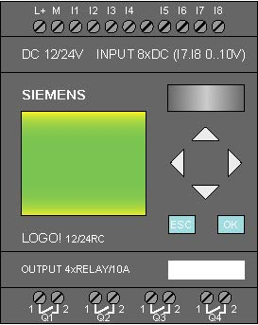

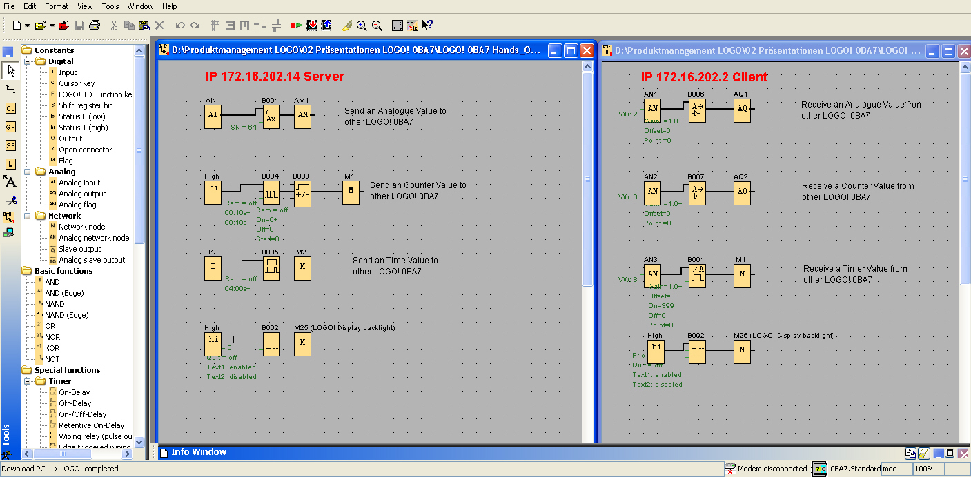
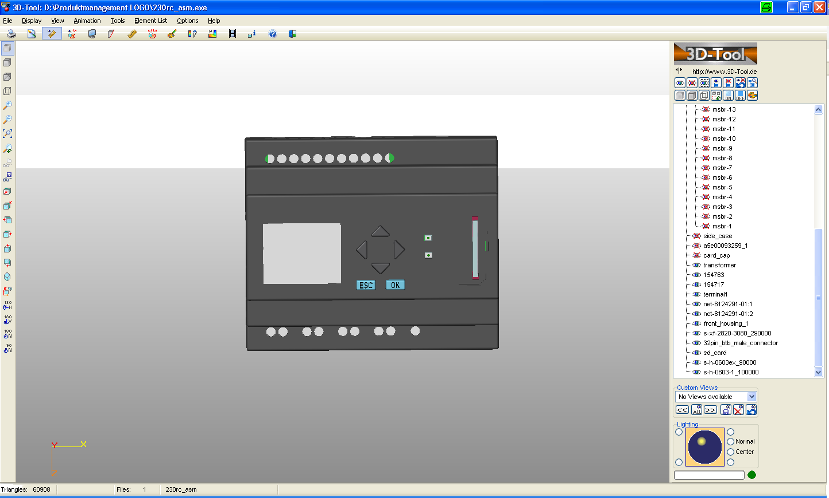
IO-Status to PC
E
E
LOGO! 0BA7 now provides you with all Status data in a csv file on the PC if you are in online test mode
On the screen you can select which data will be shown
The saved file will show all values. The can be imported to excel for further analysis

Slide 3
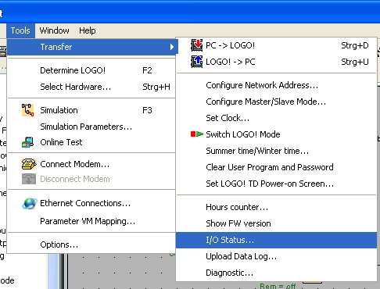
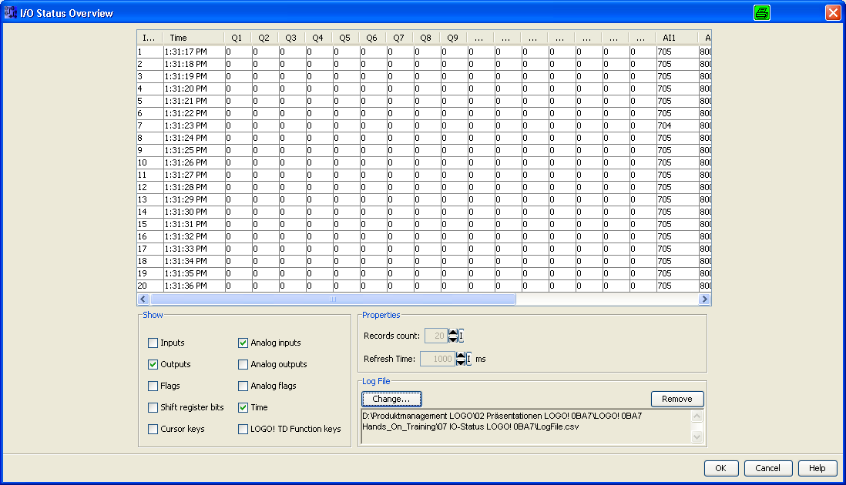
IO-Status to PC
1
2
1
Select Tool; Transfer and IO Status
2
The IO Status Overview window will be shown

Slide 4
IO-Status to PC
1
1
Status of selected data
2
Select data to be shown in the table
3
Here you can specify:
+ number of lines (20 – 100)
+ Refresh time
(0,5 – 300 secunds)
4
Here you can specify where to store the file in CSV format.
The file will increase as long as the status is running.
The file will contain all possible data ( 2 )
2
3
4

Slide 5
Networking wiht LOGO! 0BA7 V1
Thank you for your attention!
H. Schindler
I IA AS FA PS4
Phone: ++49 (0)911 / 895 - 3665
E-Mail: Helmut.schindler@siemens.com

